Slide 2

Oracle Blockchain Cloud Platform
May 2019
Vikram Kimyani UK Cloud Solutions Architect Blockchain Champion

Slide 3
Notes:
This is a Safe Harbor Front slide, one of two Safe Harbor Statement slides included in this template.
One of the Safe Harbor slides must be used if your presentation covers material affected by Oracle’s Revenue Recognition Policy
To learn more about this policy, e-mail: Revrec-americasiebc_us@oracle.com
For internal communication, Safe Harbor Statements are not required. However, there is an applicable disclaimer (Exhibit E) that should be used, found in the Oracle Revenue Recognition Policy for Future Product Communications. Copy and paste this link into a web browser, to find out more information.
http://my.oracle.com/site/fin/gfo/GlobalProcesses/cnt452504.pdf
For all external communications such as press release, roadmaps, PowerPoint presentations, Safe Harbor Statements are required. You can refer to the link mentioned above to find out additional information/disclaimers required depending on your audience.

Slide 4
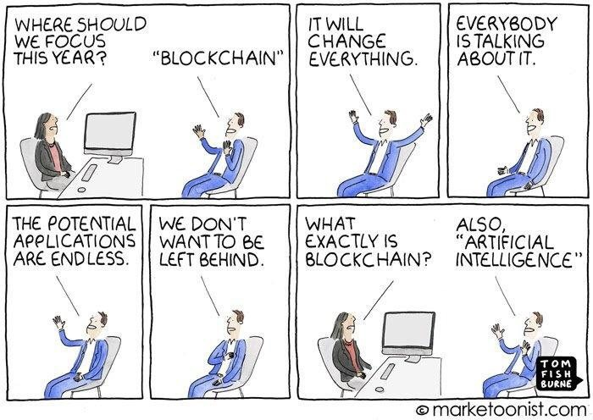
What is Blockchain?

Slide 5



The Promise of Blockchain
Business Value
2026: $360B
2030: $3.1T
Global Spend
2018: $ 1.5B
2022: $11.7B
Blockchain technology will improve all industries… E.g. Supply chains will enjoy a boost in performance that's comparable to the change from hand-written paperwork to electronic databases.
Inc Magazine, May 2018
New Development
65% of companies > 10K employees considering or active in blockchain
Notes:
ALL SIGNALS ARE POSITIVE. (perceived business value → forecasted spend → actual development)
- ADDING BUSINESS VALUE MEANS MORE INVESTMENT
65% of companies > 10K employees were considering or actively engaging in blockchain deployment
- In 2016, the blockchain was recognized as one of the top 10 emerging technologies by the World Economic Forum.
http://www3.weforum.org/docs/GAC16_Top10_Emerging_Technologies_2016_report.pdf
- Gartner estimates that DLT will result in $176 billion in added business value by 2025; that total reaches $3.1 trillion by 2030.
http://www.zdnet.com/article/executives-guide-to-blockchain/
- More than 2,500 patents have been filed in the last 3 years
http://pubdocs.worldbank.org/en/710961476811913780/Session-5C-Pani-Baruri-Blockchain-Financial-Inclusion-Pani.pdf
- 21 of 63 publicly regulated stock, futures, and options exchanges are testing DLT:
CoinDesk State of Blockchain 2016.
The most comprehensive distributed ledger cloud platform to securely extend your business processes and conduct online transactions in trusted networks with your suppliers, banks, and other trade counterparties
Definition
Secure, Trusted transactions for single and multiple party interactions
For digital commerce, messaging, and documents
Removes intermediaries, their fees, and prying eyes. Tamperproof and fault tolerant.
Commercial Opportunity
Hardens internet. Provides greater protection for PII. Faster transaction completion.
Inside an organization, consumer to organization, organization to organization
Enables trust in peer-to-peer B2B transactions, avoiding the cost and risks of intermediaries
Eliminates manual, error-prone information exchange across enterprise boundaries

Slide 6
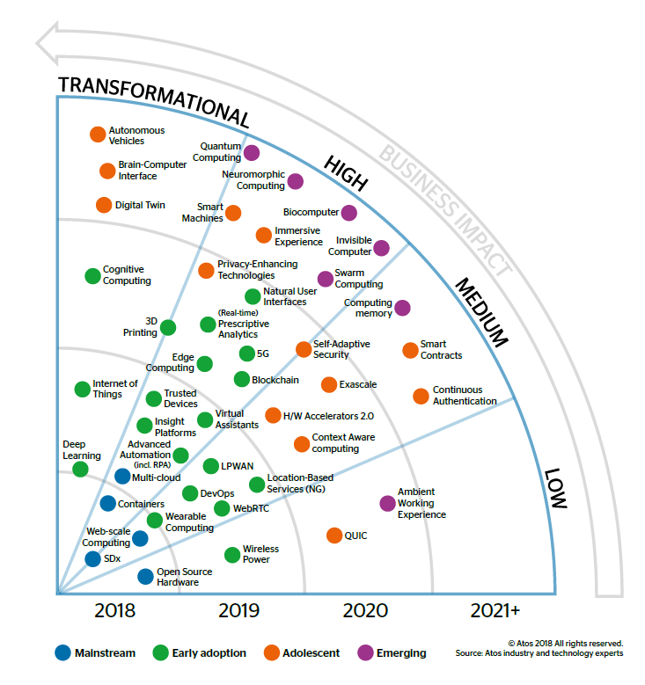
Disruptive Technology
High Business Impact in 2020
Notes:
https://atos.net/content/mini-sites/look-out-2020/assets/pdf/ATOS_LOOK%20OUT_DIGESTIBLE%20spreads.pdf

Slide 7
Blockchain’s Business Value
Reduce fraud and risk with end-to-end tracking and instant visibility. Reduce audit costs | Increase business velocity and reduce cost by delivering automation | Increase business success by enabling new business models and revenue streams
Improve data quality and timeliness by avoiding offline reconciliation and manual exception handling | Reduce cost and risk of using intermediaries

Slide 8

What is Blockchain
The ledger
The record
The block
The chain
Non-repudiable
Shared
Validated
Hashed
Linked
Immutable/Tamper Evident
Trust
8
Notes:
Explain ledger, record, block and chain
Explain what the people on the right don’t trust each other and use a trusted 3rd party
Click
Explain shared, validated/consensus/agreement, hashing, linking those hashes
Click
Explain non-repudiable and immutability. No need for the 3rd party now
Click
The properties of blockchain has enabled trust

Slide 9
Characteristics of Blockchain
Tamper-proof data
Records written to the blockchain cannot easily be changed or deleted
Enhances trust in decentralized single source of truth
Shared & Transparent
Distributed ledger enables single shared source of truth distributed across all nodes
Enables transparency, reduced delays & cost of 3rd party intermediaries
Consensus Based
Updates to distributed ledger are made after consensus among network peers
Protects against fraud among participants, and maintains trust in the ledger
Security & Privacy
Only those authorized with keys can view the data
Blockchain stores auditable historic records that can be encrypted for privacy
Enables Trust
Notes:
So what about blockchain makes it so interesting?
It starts with tamper-proof, non-refutable records. Everyone maintains an encrypted record of every transaction. To go back and change a transaction would require simultaneously taking over the entire network for an extended period of time. And that is as close to impossible as things get.
Because it's decentralized, there's no one location where everything is stored. That means better security -- and -- availability. There's no central point of vulnerability.
Finally, there's a useful industry standard that just about everyone is using -- it's called the Hyperledger Fabric, and it's being developed and promoted by the Linux Foundation. That means blockchain networks and applications can interoperate.

Slide 10
Oracle’s Approach
1
2
3
4
Adopt a Permissioned Blockchain offering
Member of the Open Source Hyperledger Fabric consortium
Make it (really) Enterprise-Ready
Built-in monitoring, IdM, Database optimizations, REST APIs, SDK, Integrations, a modern UI
Offer it as a Service (Autonomous PaaS)
Rapid, global provisioning & simplified operations, High Availability, autonomous recovery
Connect with Applications
Out-of-the-box API access in Netsuite ERP, Flexcube core banking
Plug-n-Play integration with Oracle SaaS and PaaS and custom/3rd party cloud and on premises apps
Templates for supply chain track & trace use cases and more

Slide 11
Oracle’s Blockchain Strategy
Build
Your Own
Packaged vertical solutions for specific industries and use-cases
Oracle Blockchain Applications
Partner
Blockchain
Applications
Oracle Blockchain Platform
Enterprise-Ready, Secure, Private Blockchain Platform, Productized and offered “as a Service”
Notes:
Platform: Ready to Build with Oracle Blockchain Platform
Apps: Ready to Use with packaged Oracle Blockchain Apps
Enterprise Grade Managed Blockchain Platform Service
Proven with customers across multiple Industries

Slide 12


Oracle Blockchain Cloud Service
Hardened for enterprise applications
Oracle SaaS
3rd Party SaaS
Custom Cloud Apps
CRM
ERP
HCM
CX
SCM
On-Premises Apps
Hyperledger Fabric Peers
in customer data centers or 3rd party clouds
Pre-Assembled
Oracle Blockchain Cloud Platform
REST API SDKs for Go, Java, and Node.js OIC Adapters
Governance*
Open
Smart Contracts
Confidentiality
Plug and Play Integrations
Distributed Ledger
Consensus
Open Source Hyperledger Fabric
Enterprise-Grade
Oracle Cloud Infrastructure and PaaS Services
Container Services
Identity Management
Events
Management Services
Data Services
Automated DevOps
Consortium Members
satellite nodes for private ledger data*
Oracle-managed PaaS
*coming soon

Slide 13
Oracle Blockchain Applications
Intelligent
Track & Trace
Lot Lineage and Provenance
Intelligent
Cold Chain
Warranty and Usage Tracking
Monitor transactions and movement of assets or goods across organizations
Pedigree, Serialization and Genealogy of product components
Comprehensive Track and Trace system for food and pharmaceuticals safety
Product usage tracking for Rental, Warranty, Service, & Insurance for high-value assets
Smart Contracts, Distributed Ledger on Blockchain Platform
Shipment Notifications, Bill of Lading, Manufacturing work orders
Purchase order, Sales order
Service records, Warranty information
Assets, Equipment and cargo conditions, Predictive Insights
Supply Chain
ERP
HCM
Customer Experience
Internet of Things
Notes:
https://www.oracle.com/pk/corporate/pressrelease/oow18-oracle-blockchain-applications-cloud-2018-10-23.html
Intelligent Track and Trace: MAIN APPLICATION, WILL BE LAUNCH FIRST
A full track and trace solution
Monitor the movement of assets or goods
Create a digital paper trail of each step in manufacturing, each leg of transportation, and each event throughout the supply/value chain
Pre-built analytics to help manage supply chain operations
Lot Lineage and Provenance:
Verify origin and authenticity of a product as it moves throughout the value chain
Pedigree, Serialization & Genealogy through automated capture of information about all transformations of a product
Auditable visibility and traceability into product history
Intelligent Cold Chain:
Monitor condition of goods from manufacturer all the way to the point of sale
A full track and trace solution for food and pharmaceuticals safety
Reactive and Predictive alerts of excursions
Auditable trail of all events
Outbreak preventative recommendations and root-cause analysis
Warranty and Usage Tracking:
Product usage tracking for Rental, Warranty, Service, and Insurance needs for high-value assets
Undisputable records for rented/leased product usage tracking
Auditable and verifiable log of product usage for warranty, liability claims
Increased customer satisfaction, reduced legal liabilities

Slide 14











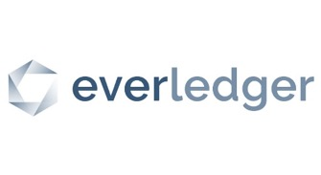


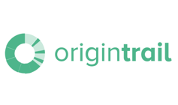








Oracle Blockchain Momentum
Securely, reliably extend business processes and accelerate B2B transactions
CG & MF SUPPLY CHAIN
FINANCIAL SERVICES
LOGISTICS
HEALTH CARE
Excise Licensing and Taxes
Remote Patient Monitoring
Extra Virgin Olive Oil provenance
Funds Transfer
Drug Counterfeit
Provenance Compliance
KYC made easy
Franchise doc exchange
Order-to-Cash
Provider Data Management
Logistics/TMS
Conflict Minerals Tracing
Secure Payment
Maritime shipping documentation
GSBN
EDUCATION
Trusted Data Exchange
FINANCE SUPPLY CHAIN
E-COMMERCE
Training record certificates
CDEL
Sustainable Fashion traceability
Invoice Reconciliation
Multi-brand loyalty
Tokenized Loyalty Points
IT SERVICES
Beer production provenance
Invoice Factoring
Access Management

Slide 15
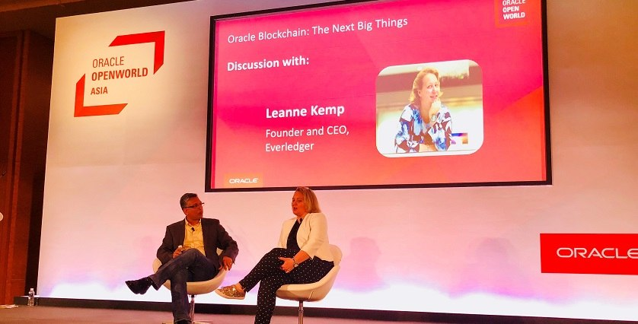
Oracle Blockchain Momentum
"The inclusion of Oracle Blockchain Platform in our offering enables us to deploy more innovative products and solutions for our customers globally, in particular with improved time to market for business intelligence reporting solutions. Oracle's comprehensive enterprise-grade offering will open our customers to realising more from our blockchain-based platform and crystalise value from the data in their own systems."

Slide 16


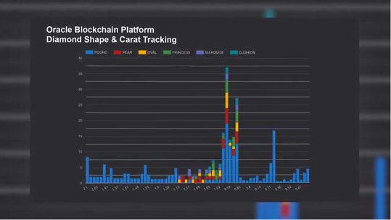



Video testimonials
Certified Origins
AJIB
Everledger
CargoSmart
HealthSynch
Alpha Acid Brewery

Slide 17

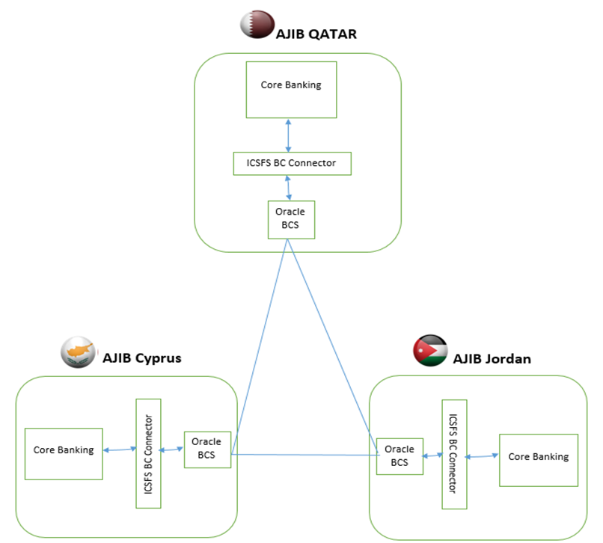

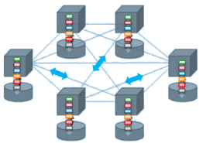

Banks: Cross Border Funds Transfer for Subsidiaries
A large bank with multiple regional subsidiaries
Current cross-border transfers between the subsidiaries use SWIFT services, which
Are not real-time and require too many manual interventions
Charge fees and other expenses
Blockchain benefits
Smart contracts enable automated transfers based on rules
Real-time handling of transfers
Integrated audit trail of transfer requests and confirmations, available to clients through mobile and Internet banking interfaces

Slide 18
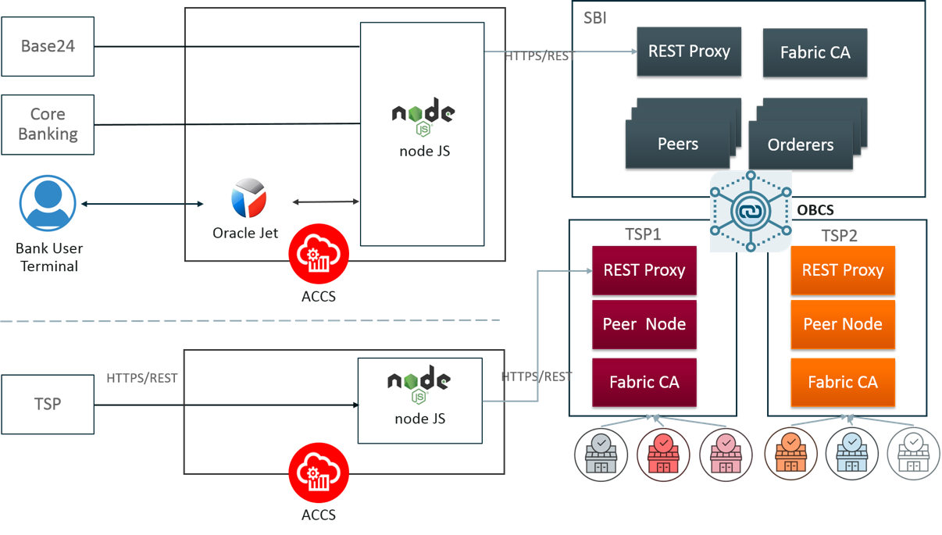
Banks: Merchant Acquisition Business Transaction and Settlement
The reconciliation issues effect Bank’s income
Manual exception/remediation process takes >3 days to resolve with the TSPs, impacting customer experience and productivity
Transaction authorization issues
EOD schedule mismatch in TSP, Bank’s ATM Switch, Bank’s Core Banking
Transaction duplication at TSP due to infrastructure issues
Automatic reversals effected by TSP post settlement
Reconciliation matching for off-us transactions is not possible since issuing bank CBS transaction logs are not available
Certain transaction components (e.g., tips) are debited at different time and mode, while the main transaction component is debited online.
Settlement related challenges
Funding and Appropriation mismatches due to dependencies on merchant effecting settlement batch close.
For Off-us the payout to the merchant is effected without the Bank being in funds from the card schemes
For Off-us cases, unsettled SMS transaction funds remain outstanding in Bank’s accounts after the corresponding transactions are settled
Publishing txns to blockchain from TSP, Bank’s Switch, and Core Banking enables:
Smart contracts on OBCS to execute automated reconciliation rules
Reconciliation application (Error Hospital) enables human review of the unreconciled transactions

Slide 19

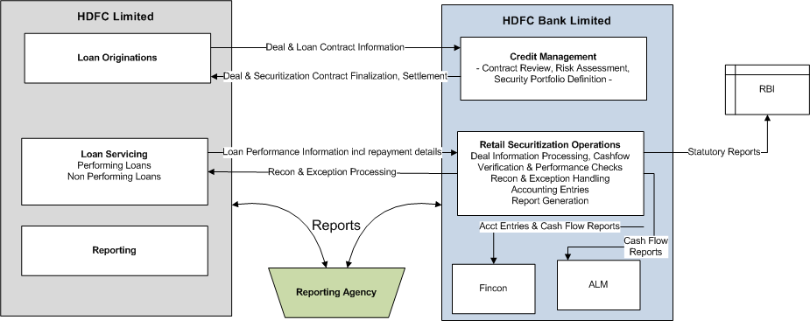
Loan Securitization Using Blockchain
Solution
End to End automation via a blockchain and smart contracts
Provides the same view of data to both parties
Uses smart contracts to verify and alert on the changes in data to act
Automates securitization reconciliation process
Continuous cash flow projections and reporting
Benefits
Provides strong audit trail
Improves efficiency and reduces processing cost
Reduces errors and manual processing
Can maintain near-real time valuations based on payments data
Enables real-time integration with core systems and reporting
Blockchain Cloud Service

Slide 20
Intercompany Accounting for Financial Transactions
Major bank with presence in over 40 countries
Multiple Financials ERPs
Complex processes for cross-charging between multiple entities and central ledger
Blockchain pilot enables Debit or Credit between legal entities in the same parent corporation
Leverages Oracle Blockchain Cloud Services with ERPM Finance applications adapters, UI and integration
Creates single source of truth on the blockchain that’s updated in real-time from all entities
Process flow
The user initiates a transfer between accounts by selecting the amount and the From and To accounts.
The client initiates this transaction on the blockchain. If it is a valid transaction, it is confirmed and the two accounts updated to reflect the transfer.
The client then calls a General Ledger SOAP web service on ERP Cloud to create a two-line Journal with a debit and credit for the appropriate accounts.
Data schema
Transaction attributes: Legal Entity (LE), Amount, Currency, Account ID, Date, Transaction Description
The other information, such as ledger, accounting period, source and category, can be defaulted or derived

Slide 21
Architecture and design

Slide 22


Effort Required To Deliver Enterprise–Grade Blockchain
Validating Nodes/ Peers
Distributed Ledger
(Single Version of Truth)
Smart Contract (aka Chaincode)
Applications
(Client SDK)
Ordering Service
Membership Service
async
Bring your own…
Identity Management
(for member enrollment)
Fault Tolerant Event Hub (for ordering event mgmt.)
Container Lifecycle Management (for system and chaincode containers)
Configuration & Monitoring Tools
Autonomous Recovery
(when components fail)
Managed Patching & Upgrades
Elastic scaling on demand
Multi-datacenter DR (with backup of ledger and config info)
Notes:
From an enterprise perspective, we are looking at permission blockchain here we need someone to authorize someone to identify. Everyone has to be identified to show who is participating on the blockchain and what transactions they are executing.
<Click1>
So, first component of course are the peer nodes. Nodes represent an organization. Blockchain is basically a business network that you are creating and there are multiple organizations participating in that. You can't have just one node in the blockchain network there have to be multiple nodes and these nodes are talking to each other over the network. It could be over the internet could be something else. So these are the nodes which are representing organization doing most of the work.
<Click2>
Of course the blockchain is a distributed ledger technology there has to be a ledger with each of the nodes. Each node maintains its own ledger -- that's where all the transaction information is stored.
<Click3>
How this information is stored is through a smart contract. A smart contract is the piece of business logic that is executed on these nodes and it looks at the world state and based on that it updates the ledger.
<Click4>
Ordering service is the centralized point of trust in a decentralized network. Ordering service helps to construct and maintain ledgers as a totally ordered hashchain of blocks of transactions that provides a verifiable history of state changes.
<Click5>
This is a permission block chain. For permission blockchain there has to be some sort of membership services and entity services which can say only these people are authorized to participate in this blockchain network. Not anyone can do a transaction -- anonymity is a feature of Bitcoin that's how Bitcoin came up because you don't want to be identified when you are doing transaction over the Bitcoin which you can be anonymous. But on this permission blockchain you have to be identified that's and there has to be a membership service there.
<Click6>
In our service we have a REST proxy to serve up APIs from the platform for applications. Using REST APIs reduces the programming complexity considerably compared to using Hyperledger Fabric SDKs directly.
<Click7>
Then if we have so many components you need some sort of admin console – some sort of monitoring tool that using which you can monitor your network. You update your network to the administration tasks
and so on so there has to be an administration console.
<Click8>
Last but not least, you have to have the end-user applications which are talking into the blockchain network so these applications can use that various API is to invoke the smart contract which will start a transaction on the blockchain network.
This is what a blockchain network component would look like in any platform.
<Click9>
All these capabilities are offered as a fully managed PaaS Cloud Service that is managed by Oracle.

Slide 23



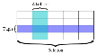


Comprehensive Blockchain Platform
Validating Nodes/ Peers
Distributed Ledger
(Single Version of Truth)
Smart Contracts (aka Chaincode)
Applications
REST proxy
P
Ordering Service
REST
Membership Service
Membership Service
SDK
Oracle value-add
Pre-assembled Dependencies
REST Proxy and Operations APIs
App
App
Ordering Service
Admin/Operations Console
SQL
Integrated backplane of supporting services
P
P
Rich integration tools for SORs & new apps
Operations
SQL-based rich queries over K-V ledger
Automated DevOps in Oracle-managed PaaS
Flexible, global, interoperable deployments
Notes:
From an enterprise perspective, we are looking at permission blockchain here we need someone to authorize someone to identify. Everyone has to be identified to show who is participating on the blockchain and what transactions they are executing.
<Click1>
So, first component of course are the peer nodes. Nodes represent an organization. Blockchain is basically a business network that you are creating and there are multiple organizations participating in that. You can't have just one node in the blockchain network there have to be multiple nodes and these nodes are talking to each other over the network. It could be over the internet could be something else. So these are the nodes which are representing organization doing most of the work.
<Click2>
Of course the blockchain is a distributed ledger technology there has to be a ledger with each of the nodes. Each node maintains its own ledger -- that's where all the transaction information is stored.
<Click3>
How this information is stored is through a smart contract. A smart contract is the piece of business logic that is executed on these nodes and it looks at the world state and based on that it updates the ledger.
<Click4>
Ordering service is the centralized point of trust in a decentralized network. Ordering service helps to construct and maintain ledgers as a totally ordered hashchain of blocks of transactions that provides a verifiable history of state changes.
<Click5>
This is a permission block chain. For permission blockchain there has to be some sort of membership services and entity services which can say only these people are authorized to participate in this blockchain network. Not anyone can do a transaction -- anonymity is a feature of Bitcoin that's how Bitcoin came up because you don't want to be identified when you are doing transaction over the Bitcoin which you can be anonymous. But on this permission blockchain you have to be identified that's and there has to be a membership service there.
<Click6>
In our service we have a REST proxy to serve up APIs from the platform for applications. Using REST APIs reduces the programming complexity considerably compared to using Hyperledger Fabric SDKs directly.
<Click7>
Then if we have so many components you need some sort of admin console – some sort of monitoring tool that using which you can monitor your network. You update your network to the administration tasks
and so on so there has to be an administration console.
<Click8>
Last but not least, you have to have the end-user applications which are talking into the blockchain network so these applications can use that various API is to invoke the smart contract which will start a transaction on the blockchain network.
This is what a blockchain network component would look like in any platform.
<Click9>
All these capabilities are offered as a fully managed PaaS Cloud Service that is managed by Oracle.

Slide 24
Hyperledger Fabric 1.3 Support
One of the first Hyperledger members making this release available in production BaaS
Key New Features
Chaincode in Java to broaden talent pool of developers creating chaincode
Private data collections for keeping certain data/transactions confidential to a subset of channel members
Service discovery to simplify client applications
Key-level endorsement policies enable more granular, customizable endorsement rules to be set from the chaincode
Access control for peer node functions (system resources via system chaincode)

Slide 25


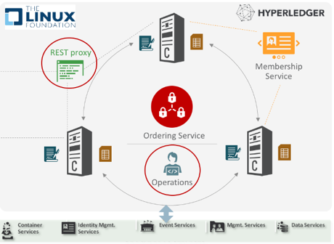


Ease of Integration and Systems of Record Connectivity
REST API-DRIVEN INTEGRATION
Invoke txn’s in sync & async mode
Get txn status
Register event callback URL
Query ledger data
Provisioning API
Operations/Configuration APIs
ORACLE INTEGRATION CLOUD
Adapters for Oracle & 3rd party applications in cloud and on-prem: ERP, SCM, CX, HCM…
Technology adapters (MFT, JMS…)
Turn application events into REST calls to run blockchain transactions
Apps
Apps
JAVA, GO, AND NODE.JS CLIENT SDKS
Invoke txn’s asynchronously
Get txn status
Query ledger data
Subscribe to events
Add channels/peers
Enroll new members
NEW SAAS BLOCKCHAIN APPLICATIONS
Supply chain track & trace use cases and more
Oracle GBU applications in selected industries

Slide 26
Rich Data Access
Open source HLF provides two World State K/V stores: Leveldb and Couchdb
OBCS implemented World State K/V store using Berkeley DB
Record-level locking for greater concurrency of endorsements and commits
Much stronger rich query support (attribute-based queries in K/V store)
SQL-based rich queries
CouchDB query syntax for compatibility
Results are embedded in merkle trees and, unlike Couch DB, verified at transaction commit time
Order of magnitude faster than CouchDB

Slide 27
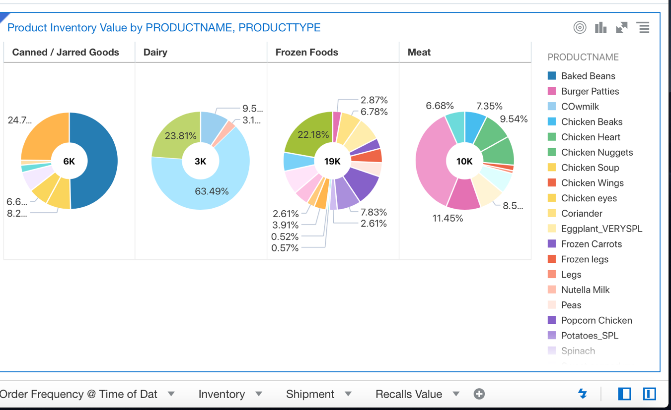
Rich History DB for Analytics/BI Integration
Parallel with regular history DB updates, we asynchronously update Oracle DBaaS for every transaction commit
Maintains rich data model
Accessible for Analytics/BI/DWH reporting, interactive dashboards, etc.
Enables random history searches
OAC Dashboard Examples

Slide 28
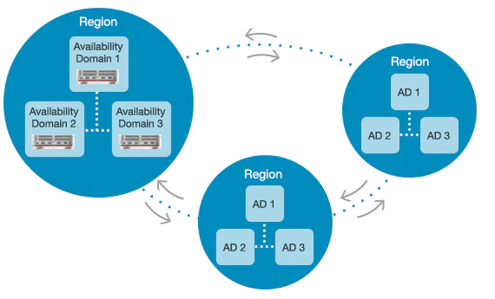
Flexible, Global Blockchain Network Topologies
Oracle Cloud Datacenters
Customer Datacenters
Oracle Blockchain Platform
Private Cloud Service*
Open source deployed on-premises or on a 3rd party cloud
*coming soon

Slide 29
Walk-thru

Slide 30
Summary, Resources and Q&A

Slide 31
Oracle Blockchain Cloud Makes Blockchain Easy
Easy-to-Deploy: Production Ready
Easy-to- Integrate
Easy-to- Control Access
Easy-to-Monitor and Manage
Pre-assembled: automatic provisioning of network and infrastructure resources
APIs and SDKs to integrate with Oracle and non-Oracle applications
Identity management and granular access controls
Admin console for management,
Hyperledger Fabric technology for interoperability
Notes:
Oracle's goal is to make blockchain easy to put to work.
Our blockchain cloud service is an industrialized blockchain platform, designed for the enterprise:
It's ready to go: preassembled and easy to deploy.
<CLICK>
It's easy to integrate. We've provided a wide range of software development kits and APIs to make it very straightforward to connect to both Oracle and non-Oracle applications.
<CLICK>
It's easy to secure and control access. Our blockchain service leverages our powerful identity management service, so, it's easy to control access as needed
<CLICK>
And it's easy to monitor and manage. Of course, we provide our own administrative console, or -- since our blockchain service conforms to industry standards -- you can use your own operational tools, as you prefer.

Slide 32
BCS SDK 19.1.3 Release
Purpose is for application dev and evaluation
Same set of features as v19.1.3 in cloud
Exceptions: Security, HA, backup, etc.
Plan to release a new version along with cloud release
No patch or upgrade – users are expected to create new instances
For Customers & Partners
OBP SDK is now available for customers/partners to download at OTN: https://www.oracle.com/technetwork/topics/cloud/downloads/blockchain-sdk-5443939.html
Support via community forum

Slide 33

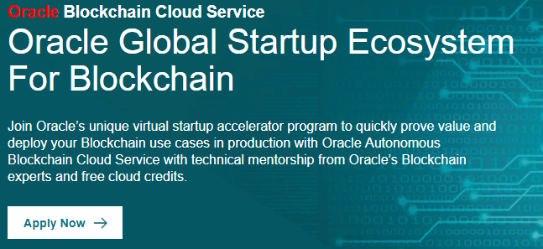
Learn More
http://oracle.com/blockchain
http://cloud.oracle.com/blockchain
http://developer.oracle.com/blockchain
Next Steps
https://www.f6s.com/oraclescaleup
Q&A

